Slide 1
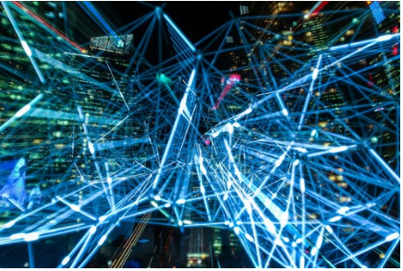
Improving the Response to NYC “Social Distancing Violation” Reports
Greg Berry
April 09,2020

Slide 2

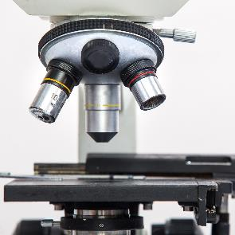




Improving the Response to NYC “311 Social Distancing Reports”
Introduction:
Currently , in response to the Covid 19 virus, NYC has a “Social Distancing” law in effect that allows residents to make a police report using the 311 system.
Each such 311 report uses police resources to respond.
Many of the 311 reports end up being “unactionable” due to a variety of reasons.
Finding a way to detect which reports may have a higher likelihood of being “actionable” as well as understanding underserved/poorly served areas of the city would allow allocation police resources to discourage social distancing violations resulting in savings for the police of time and money.
Community Leaders may have an interest as well
1
2
3
4
5
6

Slide 3
Data Acquisition and Cleaning
NYC Open Data for 311 Calls
Foursquare Venue Search and Categorization
311Social Distancing Reports (311SDRs) can be found in the NYC Open dataset found here: (https://opendata.cityofnewyork.us/calls).
In total 1,000 rows with 30 categories of information were gathered using RESTful API call.
Calls with no latitude/longitude were dropped
Data was pruned to useful columns
Additional columns were created to support data analytics
Foursquare venues and categories can be obtained here: (https://foursquare.com/).
Venue data was obtained for each 311SDR, using parameters of 160 feet from incident location and a maximum of 100 venues.
In total 7,932 rows of venue data were retrieved.
Venue locations needed to be categorized so an additional call was made to the Fousquare API to retrieve over 944 rows of venue category data.

Slide 4
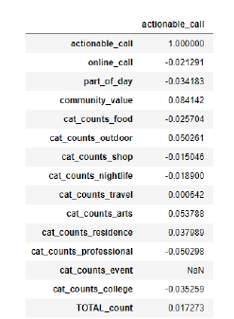
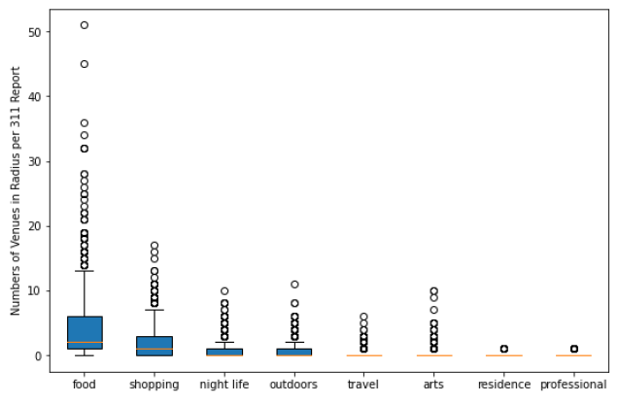
Correlations Between 311SDRs and Foursquare Venues
Analysis revealed no correlation between Foursquare venues and actionability of 311SDR calls.

Slide 5
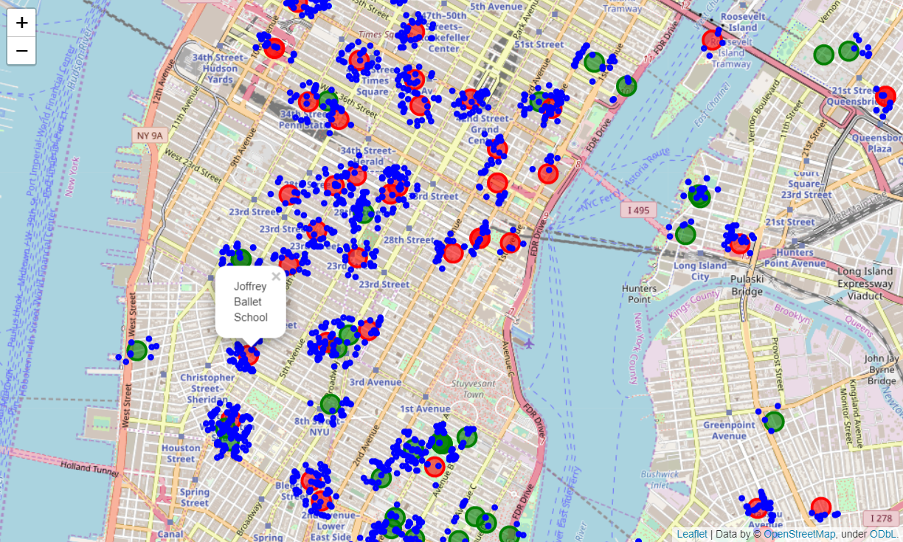
Geographical Data Visualization
KEY:
Blue Dot = Foursquare Venue
Red Circle = Unactionable 311SDR
Green Circle = Actionable 311SDR
Social Distancing Reports with Social Venues Displayed

Slide 6
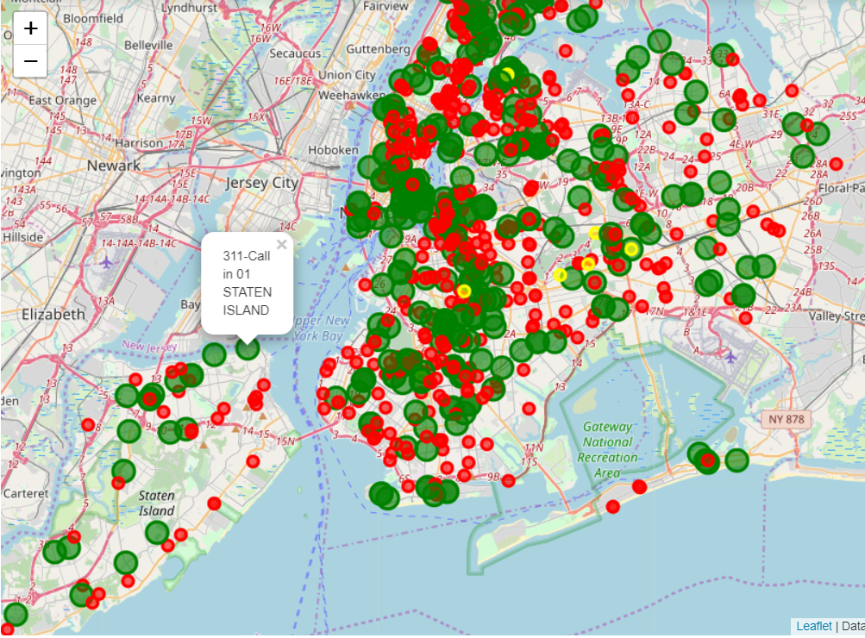
Geographical Data Visualization
KEY:
Red Circle = Unactionable 311SDR
Yellow Circle =
Green Circle = Actionable 311SDR
Social Distancing Reports without Social Venues Displayed

Slide 7
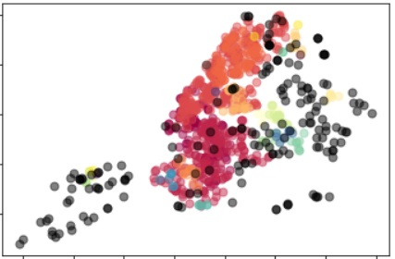
DBSCAN Model
Key:
Black Points = Outliers
Colored Point = Cluster of similarly actionable / unactionable 311SDR Calls
DBSCAN (epsilon = .3, samples=5)

Slide 8
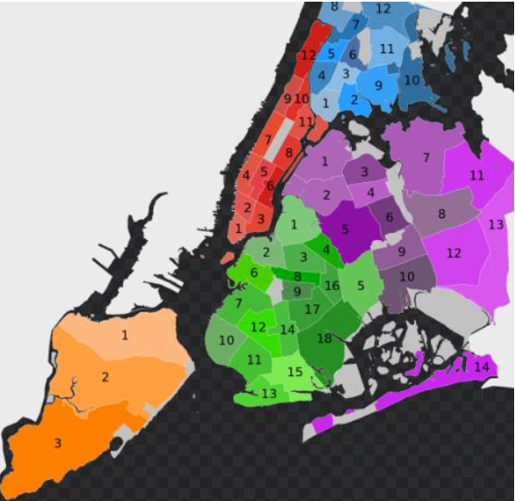
Conclusion and Future Directions
Disproved correlation of 311 Social Distancing Violation Report Locations to nearby Foursquare Venue Categories.
Visualizations showed clear signs of clustering of actionable and non-actionable 311SDR.
Need more data to determine cause of clustering.
Ideas include:
Location of NYC Police Departments
Location population Density by latitude and longitude
Socio-economic values for neighborhoods where 311SDR calls were processed
This map of NYC Community Board regions is an example of the types of data that may be needed to improve understanding of 311SDR Clustering and facilitate predictions.

Slide 9
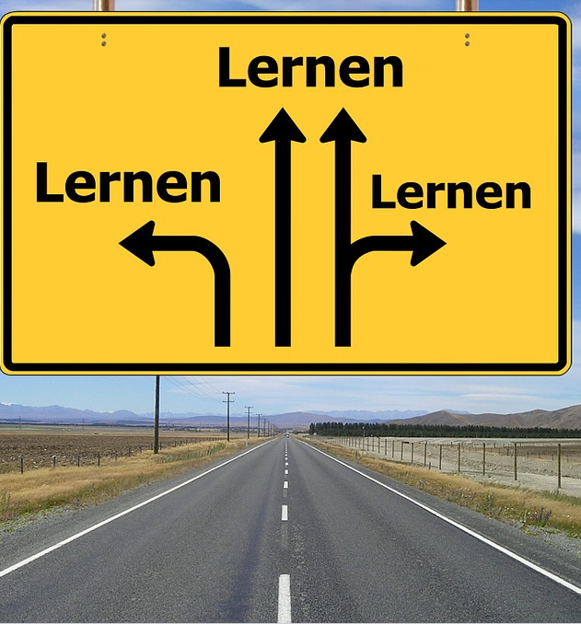

Thank You
Greg Berry
biffalobulls@Hotmail.com

